Slide 1
SUPERVISED
REGRESSION MODEL
Kaushal Khatiwada
Roll Number 13

Slide 2
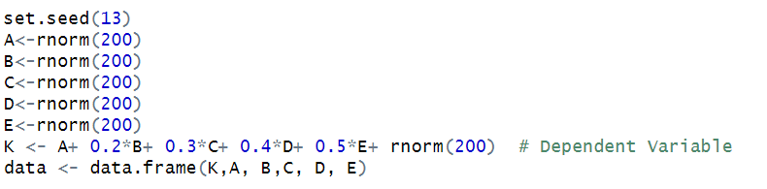
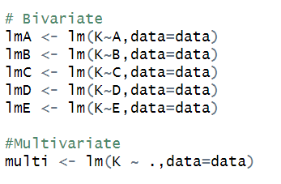
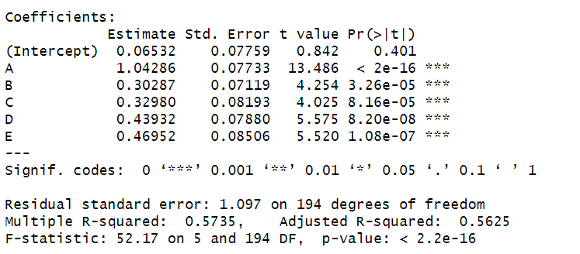
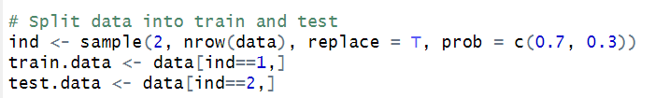
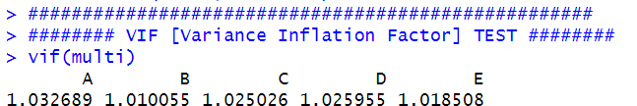
Supervised Regression Models
Generated a Random Normal Distributed data
Fit Bivariate and Multivariate linear regression model
Split into Train and Test
3) VIF < 10 so,no multicollinearity

Slide 3
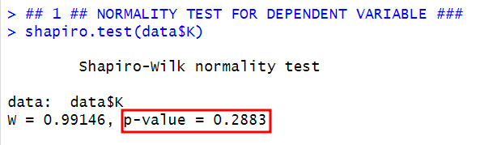


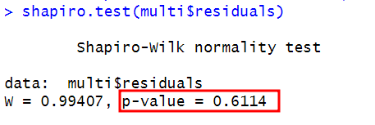
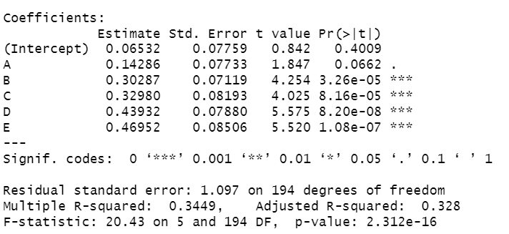
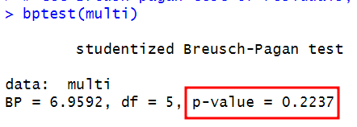
BLUE and LINE
P-value > 0.05, so dependent variable normally distributed
Coefficient of correlation are positively correlated
R-squared is between 0 and 1 therefore the model perfectly predicts the outcome

Slide 4
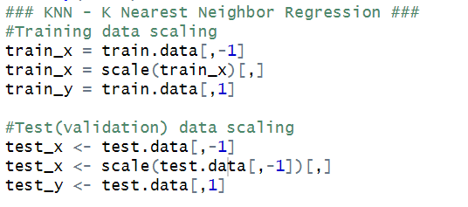
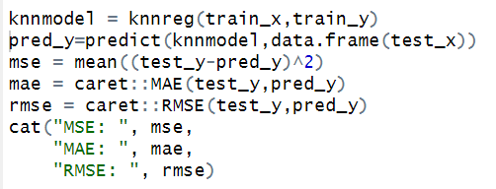
KNN

Slide 5
ANN

Slide 6
SVR

Slide 7
THANK YOU

